Slide 1

CONTEXT SWITCHING
SRM INSTITUTE OF SCIENCE AND TECHNOLOGY
COLLEGE OF ENGINEERING AND TECHNOLOGY
DEPARTMENT OF NETWORKING AND COMMUNICATIONS
21CSC202J-Operating Systems , Mini-Project Presentation
Student 1 Reg No: RA2211032011053
NAME: S.YAFFIN
Guide name and Designation: HEMAMALINI V
Associate Professor
Department of Networking and Communications

Slide 2
Table of contents
Objective
Problem Statement
Flow chart
Model Diagram
Implementation
Results
Reference

Slide 3
Problem Statement
I have implemented Context Switching and RR scheduling.
We need to do Context Switching whenever Process switch takes place.
Here Scheduling is done, so whenever time slice of one process is completed, processor is allocated to next process,for this we need to save the state of process so that next time it should run from where it was left.
We have implemented context switch for Scheduling and I/O interrupts

Slide 4
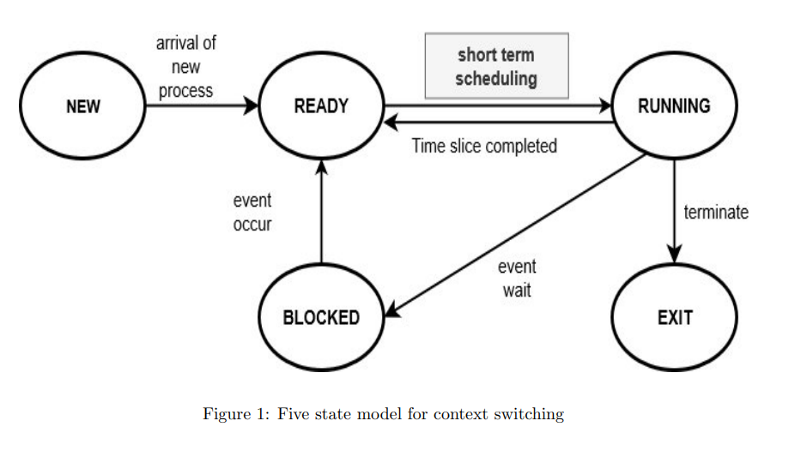
MODEL DIAGRAM

Slide 5
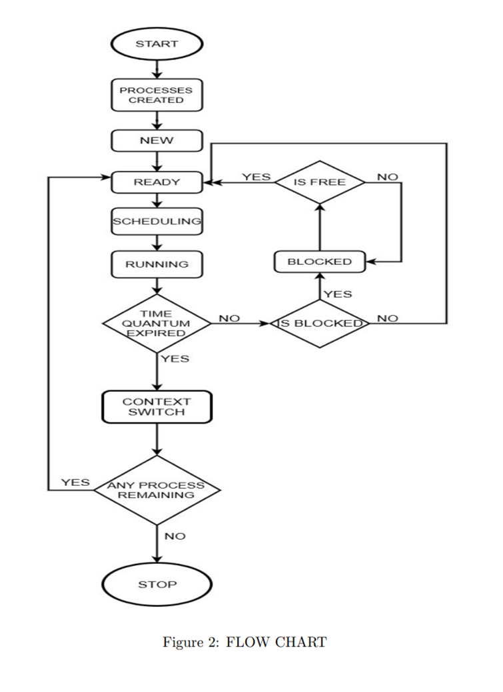
FLOW CHART

Slide 6
PROCESS MODULES AND FILES
Main.c It contains all operations such as process creation, scheduling , context switch, updating PCB and GUI, which is implemented using GTK.
To run : /gcc ‘pkg-config gtk+-3.0 --cflags‘ main.c stack implementation.c queue implementation.c -o os ‘pkg-config gtk+-3.0 --libs‘ ./os
stack implementation.c It contains stack implementation for push,pop operations
queue implementation.c It contains queue implementation for enqueue, dequeue operations

Slide 7
IMPLEMENTATION
Four processes are added to four different text files and in which instruction for process is given. Ready queue is formed using circular queue.
Now scheduling is done, for every quantum when process runs, its PC is incremented, completed time for particular running process increases by quantum, 2 instructions are executed in one quantum and value of variables are PUSH-ed in stack of that process.
Whenever that process again gets processor to execute, value of this registers is used. After this, next process which is in ready queue gets turn and execute instructions in similar way.
This will continue until any of the process gets blocked. Whenever any process gets blocked, it is added to block queue and processor is given to next process.
When needed resource for blocked process is free/available, it is again added o ready queue. As a result we are showing before and updated PCB of each process. Resources are blocked and released through GUI.

Slide 8
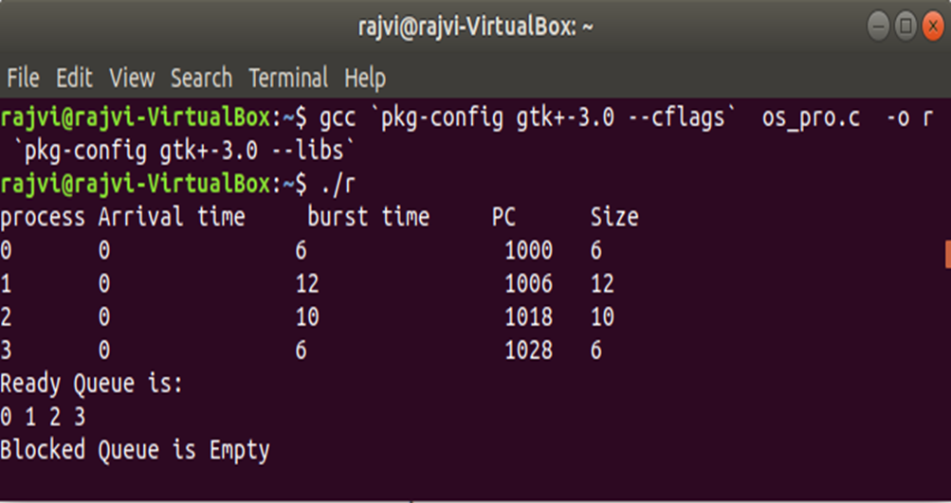
RESULTS
Figure 3: process block

Slide 9
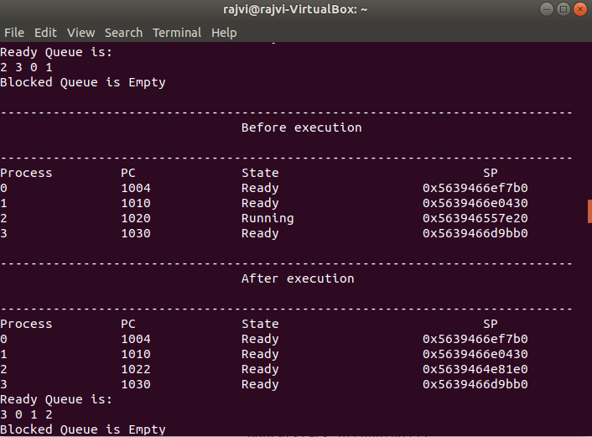
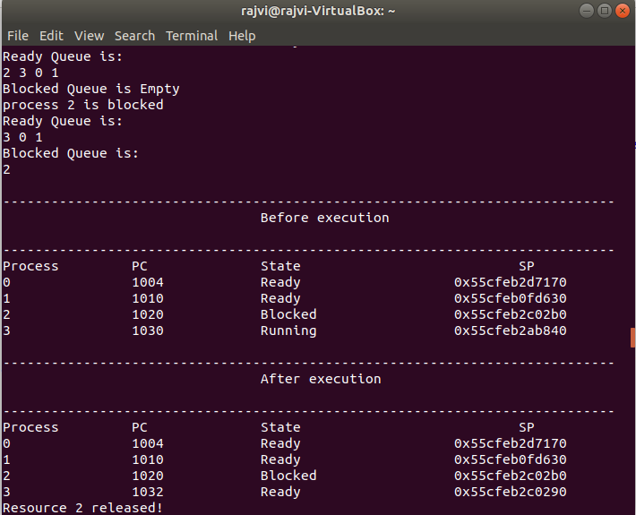
Figure 4: Normal execution without any process blocked
Figure 5: when process is blocked

Slide 10
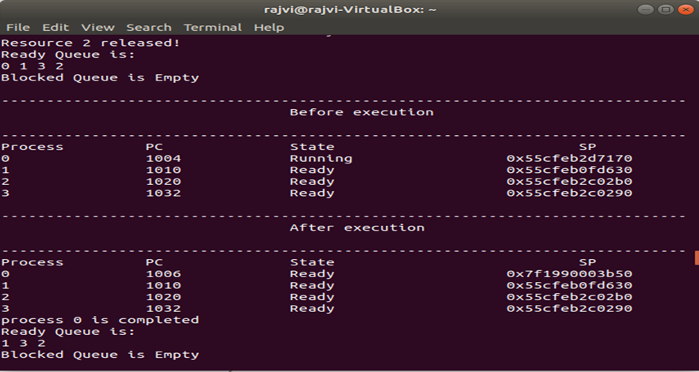
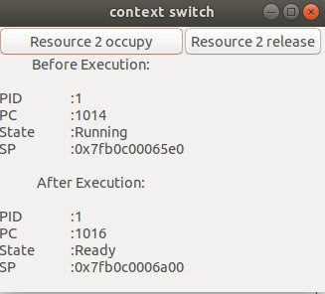
Figure 6: when process is relesed
Figure 7: GUI

Slide 11
Thanks

